Slide 1


20th Annual Family Café Conference
2018
Rick Scott
Governor
Barbara Palmer
Director
Notes:
Good Afternoon Everyone. I’m Lydia Bustillo, the CDC+ trainer and outreach coordinator of APD, the Agency for Persons with Disabilities.
I hope that you will find this presentation very informational and help you determine if the CDC+ program is right for you.
How many people in the audience are already on the program? Or on the waiting list? Let’s begin

Slide 2

Introductions
Rhonda Sloan,
Administrator
Meghan Kirkley,
Program Administrator
Lydia Bustillo,
Training and Outreach Coordinator
2

Slide 3

Presentation Overview
What is the CDC+ Program?
Description
Responsibilities
Updates
CDC+
3
Notes:
This presentation will provide information about the CDC+ Program, Responsibilities and Updates.

Slide 4

CDC+ History
Began in 2000 – research-Consumer-Directed Care (CDC)
January 2004 – Consumer-Directed Care Plus (CDC+) demonstration phase
March 2008 – CDC+ became a permanent Florida Medicaid State Plan Option
As of June 6, 2018 a total of 3,176 people are actively managing their CDC+ budget
4
Notes:
The CDC+ Program began in 2000 as an 8-year research and demonstration project called Consumer Directed Care (CDC)
We go thru the process of training and enrolling new participants into the CDC+ Program on a monthly basis

Slide 5


What is CDC+ All About?
Person-centered planning
Participant-driven
Long-term care program alternative to the DD/HCBS waiver.
Principles of self determination
5
Notes:
CDC+ is a long-term care program alternative to the Developmental Disabilities / Home and Community Based Services (DD/HCBS) Medicaid Waiver.
CDC+ is based on the principles of self-determination along with person-centered planning that provides the opportunity to improve the participant’s quality of life.
CDC+ is participant-driven. This means the participant is expected to be involved in all aspects of planning for their supports and services

Slide 6

Main Focus of the program
Provide the consumers an opportunity to improve the quality of their lives and services.
Help the consumer meet their identified goals and needs.
Allow the consumer to gain more independence.
6

Slide 7

Self-Determination and
Person-Centered Planning
FREEDOM
AUTHORITY
SUPPORT
CONTROL
RESPONSIBILITY
7
Notes:
There are five principles of Self-Determination.
FREEDOM to decide where and with whom an individual lives.
AUTHORITY to decide how the individual will live his or her life.
SUPPORT the individual’s need to make decisions.
CONTROL over the resources needed for an individual’s support.
RESPONSIBILITY for an individual’s decisions and actions.
In CDC+, YOU are, indeed, in the driver’s seat.

Slide 8
The Participant Controls
WHAT
WHO
WHEN
WHERE
HOW
8
Notes:
In the CDC+ program the participant is in charge of…
WHAT supports and services are purchased
WHO provides the supports and services
WHEN supports and services will be provided and the quantity
WHERE supports and services will be provided AND
HOW supports and services will be provided

Slide 9
Comparison of
Waiver vs. CDC+ Program
CDC+ Program Services
(8% + 4%= 12% reduced budget)
iBudget FL services PLUS…
  Advertising
  Seasonal Camp
  Gym Membership
  Over the Counter Medications
  Personal Emergency Response
  Parts & Repair
  Therapeutic Equipment
  Specialized Training
  Other Therapies
  *** Save up for these services or additional hours…
iBudget FL - Medicaid Waiver
Seven (7) Service Families
  Life Skills Development
  Supplies & Equipment
  Personal Supports
  Residential Services
  Therapeutic Supports
  Transportation
  Dental
  *** must use Medicaid Waiver providers and established rates
9

Slide 10

Eligibility to enroll in
the CDC+ Program
Must be currently enrolled in DD/HCBS iBudget waiver
Live in own home or family home
Select a certified CDC+ Consultant
Take CDC+ Trainings
Pass Readiness Review with score of 85% or better
10
Notes:
Are you eligible for the CDC+ Program?
this Application/Enrollment Process will take at least 45 days or more

Slide 11


CDC+ Monthly Budget
CDC+ is funded at a 92% discounted rate.
  Discount rate applied
  Administrative fee applied
Flexible CDC+ Monthly Budget
CDC+ allows for a larger array of services than are available on iBudget
11
Notes:
A CDC+ participant’s monthly budget is based on the cost of services that a participant has been approved to receive in the DD/HCBS waiver Cost Plan.
A discount rate and administrative fee are subtracted from the Cost Plan total.
CDC+ allows for a larger array of services than are available on iBudget to meet the your needs and goals and you are able to hire people who are not waiver providers. This greater choice and control comes with higher responsibility.
CDC+ has no funding, all funding is awarded by the iBudget waiver.
There were also stakeholder meetings held around the states where parents stated, ‘Give us control and we can provide the same services cheaper’. The 8% stays at Medicaid. Approximately 4%

Slide 12

Building Blocks of a
CDC+ Purchasing Plan
Support Plan Cost Plan
Purchasing Plan
12
Notes:
Lets build on what we know:
The Support Plan documents the Participant’s current needs and goals for services and support and is used to build the Cost Plan which details the allowed maximum spending for each waiver service.
A participant’s monthly budget is calculated from the current approved cost plan.
When the monthly budget has been determined using the Cost Plan a Purchasing Plan can be completed.
When the Purchasing Plan has been approved by APD, the participant may begin managing the CDC+ monthly budget

Slide 13
Purchasing Plan Timelines
Person Responsible | Activity | Due Date
Consumer (Representative) | Complete Purchase Plan; submit to Consultant | On or before the close of business by the 5th of the month
Consultant | Review and sign; submit to Regional Liaison | On or before the close of business by the 10th of the month
Regional Liaison | Review and sign; submit to State Office | On or before the close of business by the 20th of the month
Notes:
There are just a few things you need to know about Purchasing Plans.
Purchasing plan is a monthly plan of spending. We offer a training dedicated on how to write a Purchasing plan. We will fill out a purchasing plan live during that training.
All Purchasing Plans have an effective date of the first (1st) day of any given month.
For additional information on Purchasing Plans, reference the CDC+ Rule Handbook

Slide 14
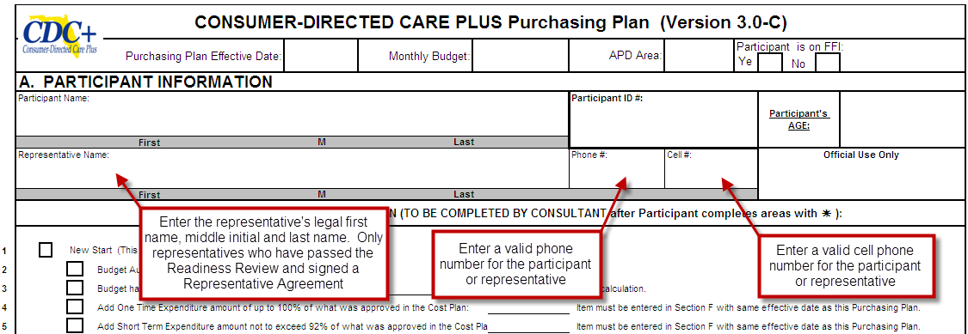
Purchasing Plan (version 3.0-C)
Purchasing Plan Development
14
Notes:
Use current version 3.0C when developing your Purchasing Plan.

Slide 15

Your CDC+ Team
Participant, Representative, Consultant, Liaison, State Office Program & Fiscal Employer Agent
15
Notes:
CDC+ TEAM Participant, Representative, Consultant, Liaison and Fiscal Employer Agent

Slide 16

Participant
Decision Maker
Trainee
Employer
Authorized Signer
Manager of the CDC+ Program
16
Notes:
They must decide if they can manage all CDC+ Requirements on their own, or if someone else should do so on their behalf (Representative).
they must participate in all required CDC+ Trainings.
They hire, terminate and manage all their providers, making changes as needed. They are enrolled as household employers with the IRS and get an employer ID number to them.

Slide 17



The Representative
Must be 18 years of age
Cannot be Paid
or
Benefit from any business authorized to provide services to or for the participant
17
Notes:
The role of the CDC+ Representative is much the same as the Consumer. They must make decisions on behalf of the Consumer, managing all CDC+ care and financial responsibilities.
CDC+ representatives must be at least 18 years of age.
CDC+ representatives, should be intimately involved in the participant’s life and support their wishes and needs by making the best choices for them.
CDC+ representatives cannot be paid or be a paid employee that provides any other service.

Slide 18

Consultant Roles
CDC+ Consultants are Medicaid Waiver Support Coordinators that are trained in the CDC+ program
Not the decision maker
Provide information, support & technical assistance
Review documentation before being submitted to APD
Ensure Medicaid eligibility
18
Notes:
The CDC+ consultant should provide information, support and technical assistance as needed for matters such as choosing supports and services to meet the participant’s needs and goal and in planning for their future needs.

Slide 19


Regional CDC+ Liaison Role
Individual APD employee
Primary contact person for the Region in the CDC+ Program
Oversee local
program operations,
Corrective Action
Plans (CAP)
19
Notes:
The Area CDC+ Liaison is employed by the Agency for Persons with Disabilities and is the contact person at the local level for CDC+ Program.
The Area Liaison will oversee local program operations, Corrective Action Plans (CAP) and Background Screening.

Slide 20




CDC+ State Office
Administer the CDC+ Program
Develop & interpret policy; Quality Assurance Monitoring
Fiscal and payroll duties
Provide customer service & technical assistance
Develop and update CDC+ training materials
20
Notes:
Staff coordinates with AHCA (the Agency for Health Care Administration) in the development of all policies and procedures for the administration of the CDC+ program and ensures that all state and federal required guidelines, policies and procedures are followed, which includes quality assurance and monitoring.
The State Office performs all the fiscal and payroll duties
Provides customer service including on-going technical assistance to the participant, representative and consultant, by answering questions and providing explanations.
Develop, updates and conducts CDC+ training materials for consumers, representatives, consultants and CDC+ Regional Liaisons

Slide 21

Background Screening Procedure
  All providers must go through Background Screening Clearinghouse prior start to offer services.
  Step by step instructions are available on the website.
21
Notes:
Background screening expenses are the responsibility of the provider, not the participant or representative.
Medicaid or CDC+ funds cannot be used for screening or rescreening providers.
Background screenings are valid for five (5) years.

Slide 22
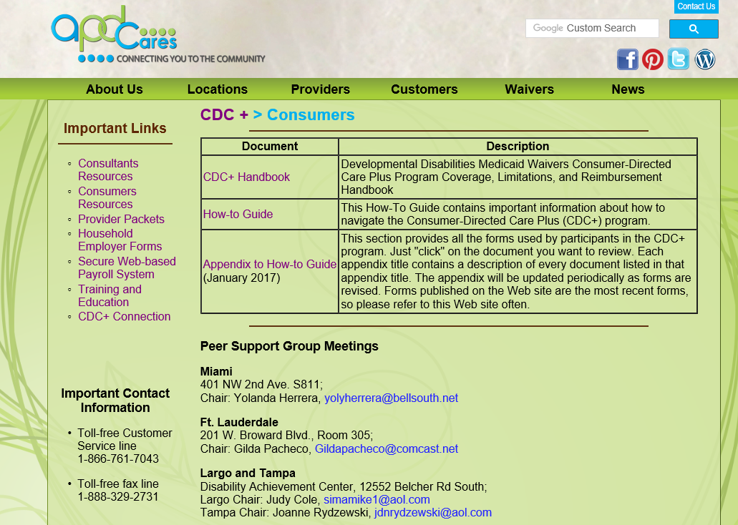

http://apdcares.org/cdcplus/consumers
  Program Toolbox
  CDC+ Rule Handbook
  How to Guide
  Appendix to the
  How to guide
22
Notes:
The CDC+ Program Participant Toolbox
The apdcares.org/cdcplus website provides a link for the CDC+ Rule Handbook, the CDC+ Participant Notebook (which is currently under revision) as well as a link for the Appendix to the CDC+ Participant Notebook
These resources are the guidebooks for the CDC+ program. Every consultant needs to be aware of the information contained in each. It is advisable for consultants to bookmark this site for quicker access when needed (e.g. when providing technical assistance to consumers/representatives).

Slide 23



Peer Support Groups in your Area
Miami
Ft. Lauderdale
Melbourne,
Tallahassee, Pensacola & Panama City
Orlando
Jacksonville, Gainesville & Daytona Beach
Largo, Tampa
  Networking
  Resources
  Join NOW!
23

Slide 24





Q & A Session
24
Notes:
You can also list your questions on the index cards and I will get back to you.

Slide 25


Thank You
Customer Service is available Monday through Friday
(8:00 A.M. – 5:00 P.M. EDT)
excluding state holidays.
CDC+ Customer Service
1-866-761-7043
25

